Slide 1
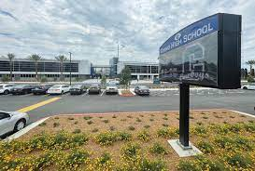
Welcome to
TPP/Study Skills
With Ms. Carlos
What you need to know about our class:
Teacher’s Background
Communication
Syllabus
Late work Policy
Curriculum

Slide 2
Education- Ms. Carlos
Chino High School - High School Diploma
CalPoly Pomona – B. A in English/Multicultural Studies
Teaching Credential
M. Ed in Special Education
Preliminary Admin. Credential
Working on EdD in Educational Leadership

Slide 3
Communication:
Materials:
Clarita_Carlos@chino.k12.ca.us
Charged Chromebook
Pen/Pencil
Highlighters

Slide 4
GRADES AND LATE WORK POLICY
Late work will be accepted every grading period (6 weeks) with no penalty. To turn in late work, you must print out the assignment and submit it to Ms. Carlos.
Excused absence work will not be considered late as long as it is turned in when you return or within the same amount of days as you were absent. Any work will be located on google classroom.

Slide 5
GRADING BREAKDOWN
A+ | 97 - 100% | C+ | 77 - 79.9%
A | 93 - 96.9 % | C | 73 - 76.9 %
A- | 90 - 92.9% | C- | 70 - 72.9%
B+ | 87- 89.9% | D+ | 67 - 69.9%
B | 83 - 86.9% | D | 60 - 66.9%
B- | 80 - 82.9% | F | 59.9 % and below

Slide 6
BEHAVIOR EXPECTATIONS
Be in your seat and ready to start class when the bell rings.
Remain in your seat unless otherwise instructed.
Listen attentively to others when they speak.
Show respect for the opinions and ideas of others.
Finish classroom assignments in the time provided.
Bring all necessary materials to class, and
come prepared to learn.
Violations of these expectations may result in the following:
Teacher assigned detention.
Counselor conference.
A phone call home.
Removal from course.

Slide 7
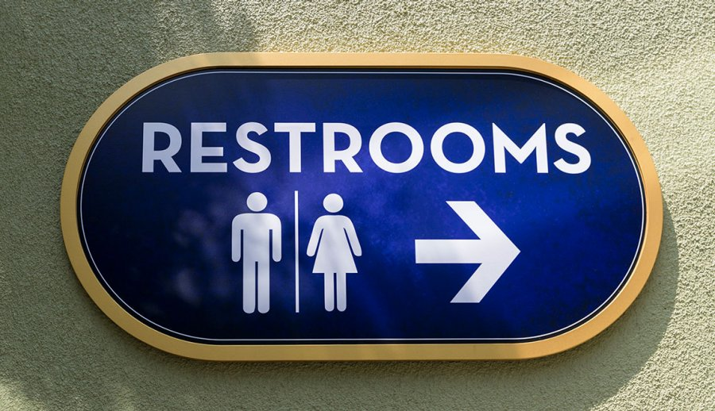
RESTROOM AND CELL PHONE POLICY
To use the restroom, students must sign in and out using the SmartPass app on Classlink.
Cell phones are not to be used during instruction UNLESS cell phones are necessary for the assignment. Phones will be taken and sent to the office if students use them INSTEAD of completing their work. For example: Your paper is blank after several minutes of work time. GAMES ON THE PHONE ARE NOT TO BE PLAYED IN THE CLASS UNLESS ASSIGNED FOR INSTRUCTION (Kahoot/quizlet).

Slide 8
Syllabus
There will be ongoing group projects and presentations, and all students will be required to participate in these group activities. For this reason, regular attendance will be an important factor in determining success in this course. There will also be several writing assignments during the year, and all students are expected to submit timely, thoughtful, well-written, ORIGINAL work. Students are expected to keep up with all reading assignments.
My expectation is for all students to succeed in this course. Not all students will finish at the “top” of the class, but all students who work hard to improve will be rewarded for their efforts.

Slide 9
Late Assignment Policy
Assignments are due at the time and date posted unless an excusable reason has been provided to the attendance office.
Late work will be graded every 3 weeks and student print out the assignment and submit it to Ms. Carlos.

Slide 10
Transition Partnership Program Curriculum
Transition Partnership Programs (TPP) were developed in response to the 1986 Amendments to the Rehabilitation Act and the 1983 Amendments to the Education for the Handicapped Act. TPPs provide enhanced, coordinated vocational services including DOR Student Services and employment preparation, job development, and short-term support services to successfully transition students with disabilities into meaningful employment.
TPP Class helps students work towards Transitional Goals in their IEP.

Slide 11
Success is Attainable
I have sat in desks very much like the ones you sit in. I have struggled with new concepts and have worked hard to improve my understanding. You are all capable of the same. Good luck on a new school year!

